Slide 1
League of Legends Analysis
By: Preston Robertson
Notes:
Introduce ourself, what we do and the department

Slide 2
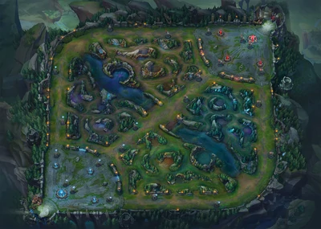

Basics/Background
2
What is League of Legends?
League of Legends (LoL // League) is an online competitive multiplayer game where two teams battle to take each other team’s nexus.
Basics of League
League is a 5v5 competitive game where each player plays a unique character and plays different positions.
Each game has its own economy where the objective is to gain money to buy the most expensive items to help win the game.
Notes:
Ask them to tell us in their own words what AM
History

Slide 3
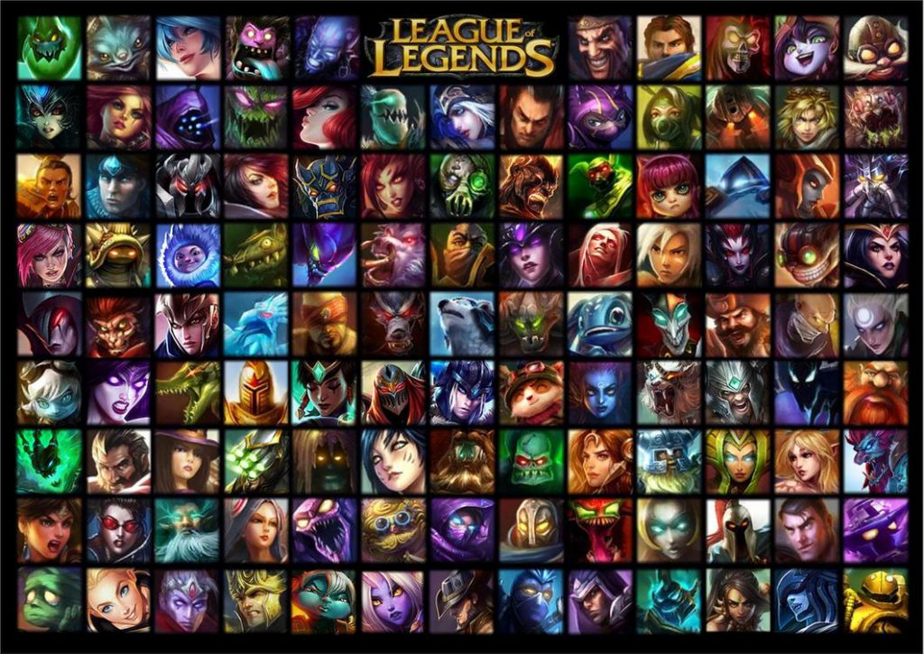
The Challenges of League
3
The Balance of League…
The game has 149 different characters to select that can go into 5 different roles (and several other factors). It is the developer’s job to ensure balance.
Unlike Football where each person is unique, individual training and effort is appreciated. If one player is stronger than the other that is fair.This is because the other player can train to be just as strong.
However, in a video game if one character is stronger than the other then there is nothing the player can do.
Notes:
Ask them to tell us in their own words what AM
History

Slide 4
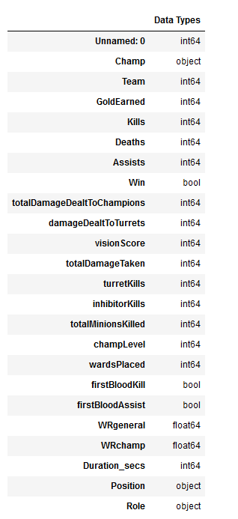
Dataset Information
4
Dataset Size
The dataset has 24 features and 23752 data points.
Obtaining the Data
This data was obtained using an API officially endorsed by Riot Games. This is the most common dataset used for analysis.
*More possible datasets in final project, they are too complicated to show in this presentation.
Assumptions due to Data
Since this data is collected from the highest level of play, it is safe to assume that the players are doing what’s best (the meta)
Notes:
Ask them to tell us in their own words what AM
History

Slide 5
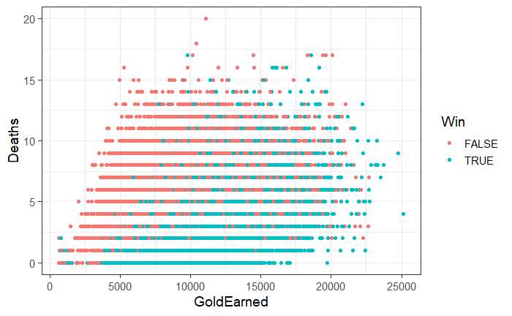
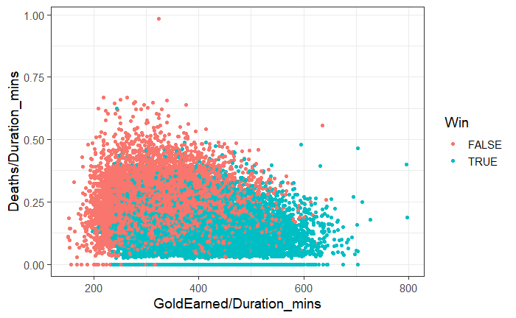
Problem with League Data
5
Notes:
Ask them to tell us in their own words what AM
History

Slide 6
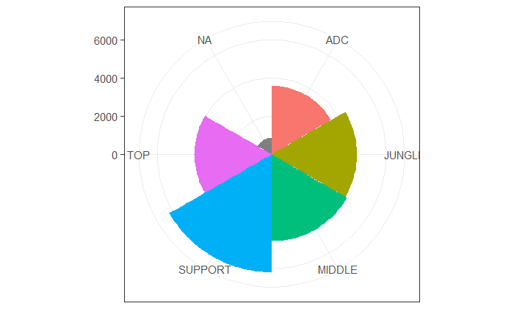
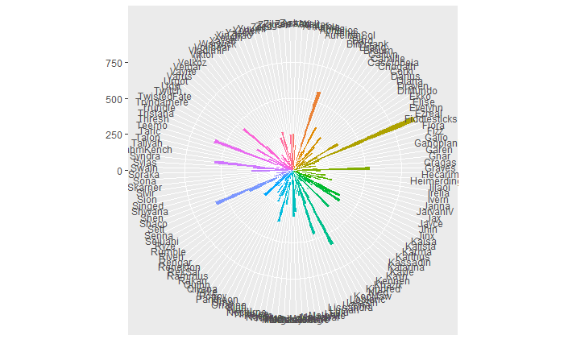
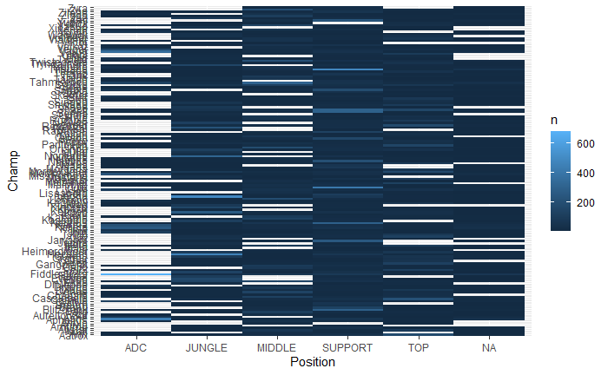
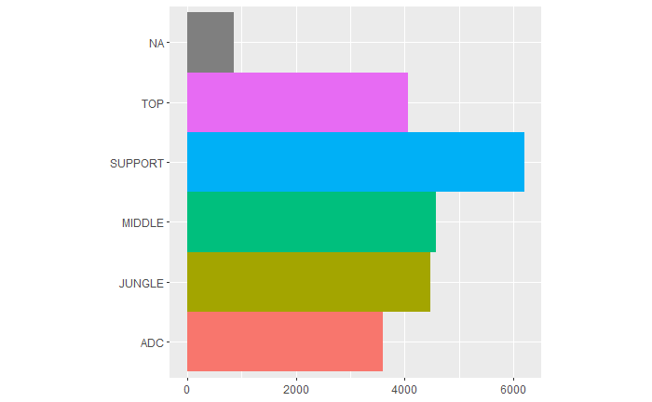
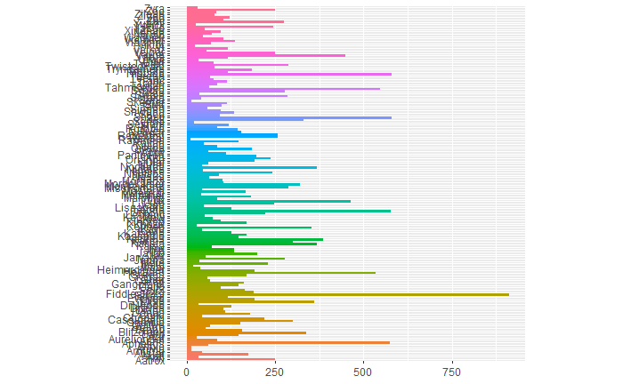
General Information
6
Role:
Champion:
Notes:
Ask them to tell us in their own words what AM
History

Slide 7
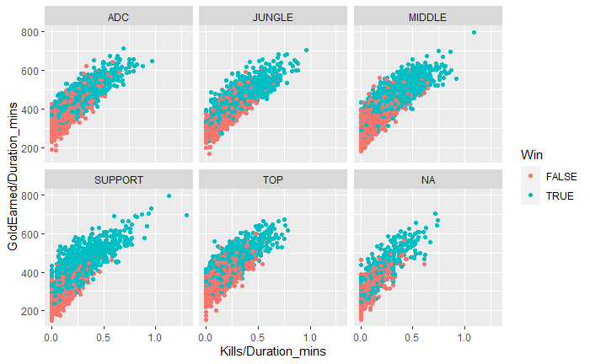
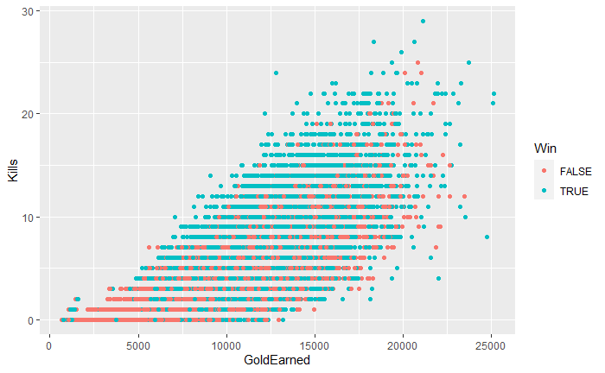
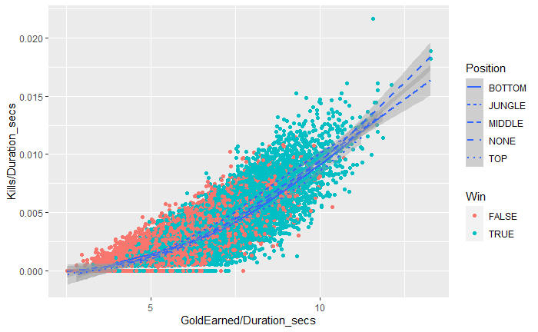
The “Best Stats”
7
Notes:
Ask them to tell us in their own words what AM
History

Slide 8
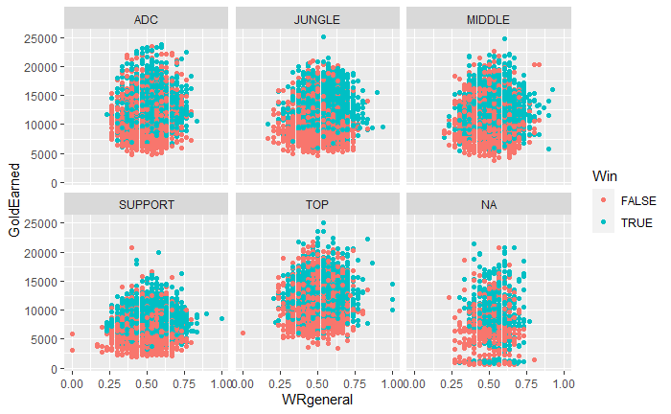
Role Impact
8
Notes:
Ask them to tell us in their own words what AM
History

Slide 9
Possible Future Work
9
Solution 1:
Taking the derivative at each point in the k iteration, instead of taking the values.
*The derivative/gradient will give more useful information but will be much harder to implement. (starting small)
Solution 2:
Implementing a small neural network to detect trends/support vectors to find mt and relay that information to the current cell.
*This would be theoretically more beneficial then averaging the next “k” cell states after mt.
…
Notes:
Ask them to tell us in their own words what AM
History

Slide 10
Questions?
Notes:
Ask them to tell us in their own words what AM
History

Slide 11
References
Objective:
…
Method:
…
Set-up:
…
Conclusion:
…
Discussion:
…
Notes:
Ask them to tell us in their own words what AM
History

